Slide 1
From Last Week 6/8/2022
Reach out to jack about 272
Prove symmetry for 0 10, 10 0 for 3 and 4 chamber design
Further explore controllability of each nozzle design
0-30psi
Build Table as discussed
Build and simulate finless model to proper spec
Remind Drew to email Ally if we haven’t heard from her
Work on square helix design

Slide 2
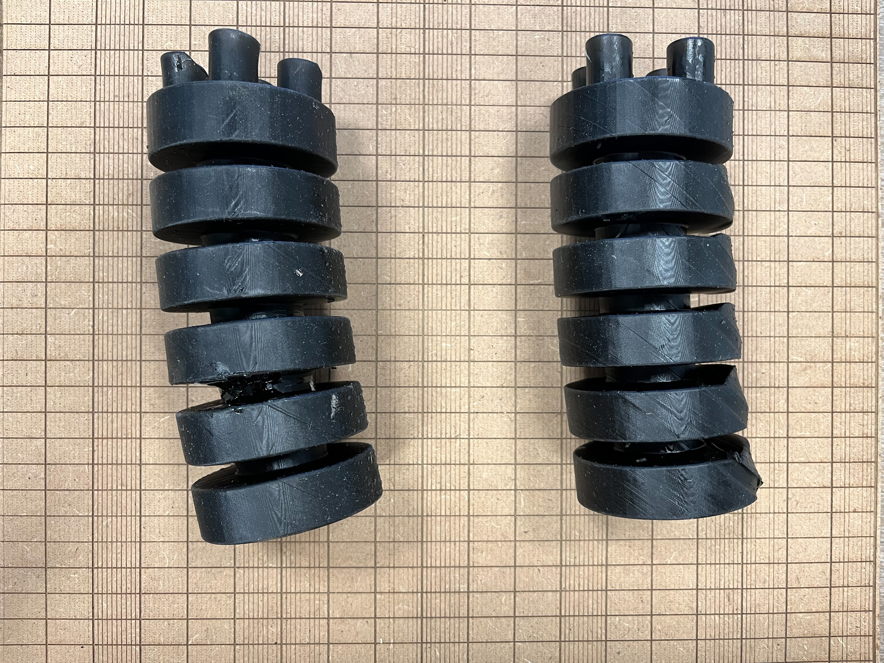
Printed Model Issues

Slide 3
4 Chamber Results
(x,y) disp. (mm) | C1 0psi | C1 10psi | C1 15psi | C1 20psi | C1 25psi | C1 30psi
C2 0psi | (0,0) | (-4.142, -4.162)
C2 10psi | (4.126,-4.135) | (0,-8.244)
C2 15psi | (6.285,-6.303) | (2.205,-10.44) | (0,-12.69)
C2 20psi | (8.515,-8.451) | (4.409,-12.71) | (2.292,-14.99) | (0,-17.34)
C2 25psi | (10.81,-10.85) | (6.86,-15.07)
C2 30psi | (13.19,-13.24) | (9.036,-17.51)
C1-10 C2-25 failed at 82.7%
C1-10 C2-30 failed at 70.5%
C1-0 C2-30 failed at 90.7%

Slide 4
3 Chamber Results
(x,y) disp. (mm) | C1 0psi | C1 5psi | C1 10psi | C1 15psi | C1 20psi
C2 0psi | 0 |  | (-8.825, -5.218)
C2 5psi | (4.360, -2.480) | (0, -5.003)
C2 10psi | (8.946, -5.095) | (4.666, -7.707) | (0, 10.52)
C2 15psi | (13.77, -7.842) | (9.423, -10.56) | (4.595, -13.46) | (0, -16.58)
C2 20psi | (18.95, -10.75) | (14.43, -13.58) | (9.884, -16.54) | (5.242, -19.78) | (0, -23.17)
C1-15 C2-20 failed at 80.2%
C1-20 C2-20 failed at 80.5%

Slide 5
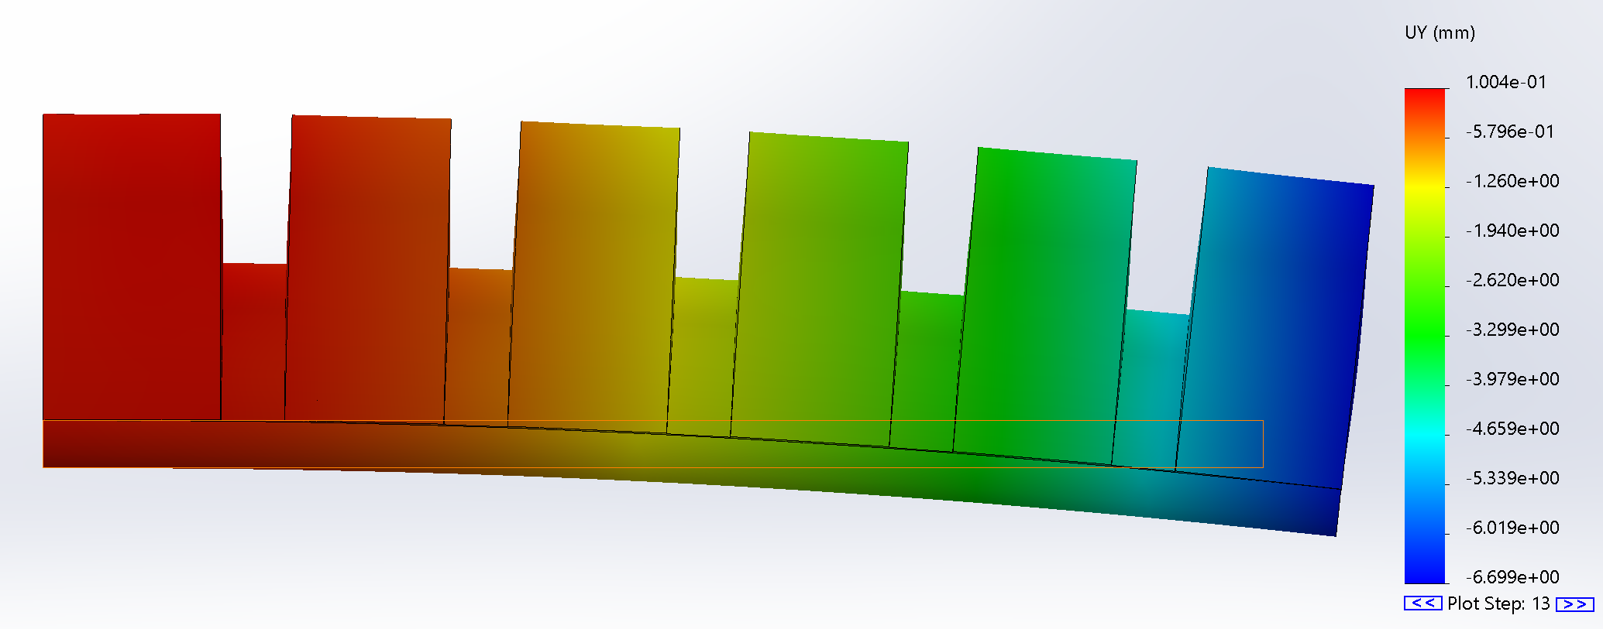
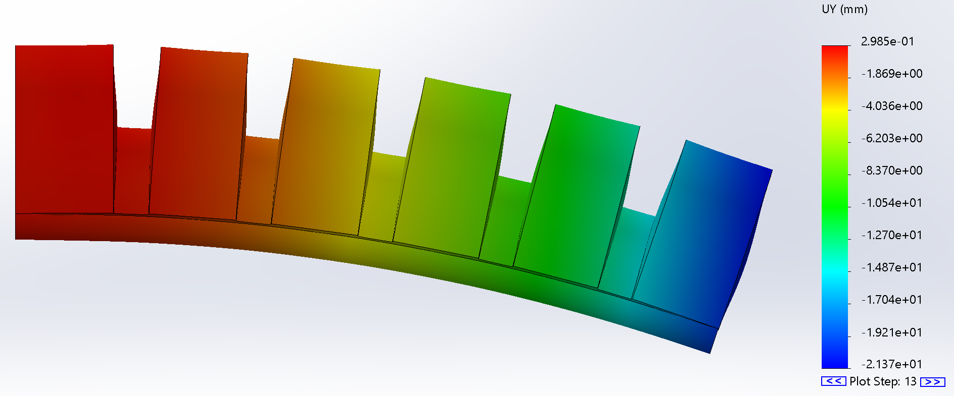
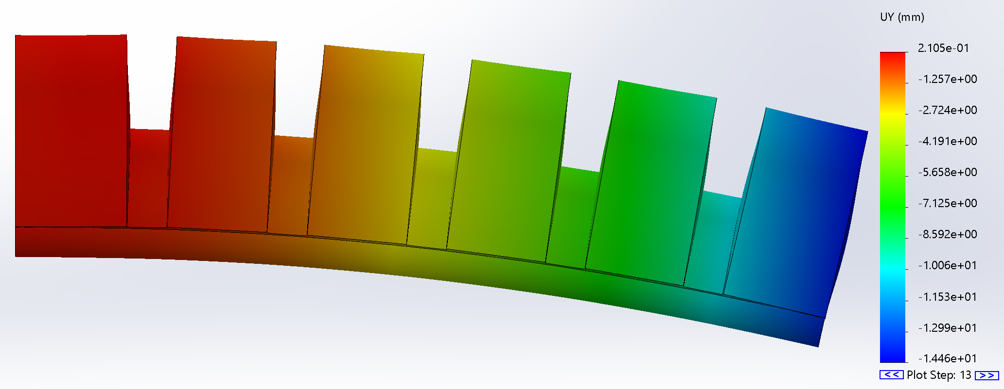
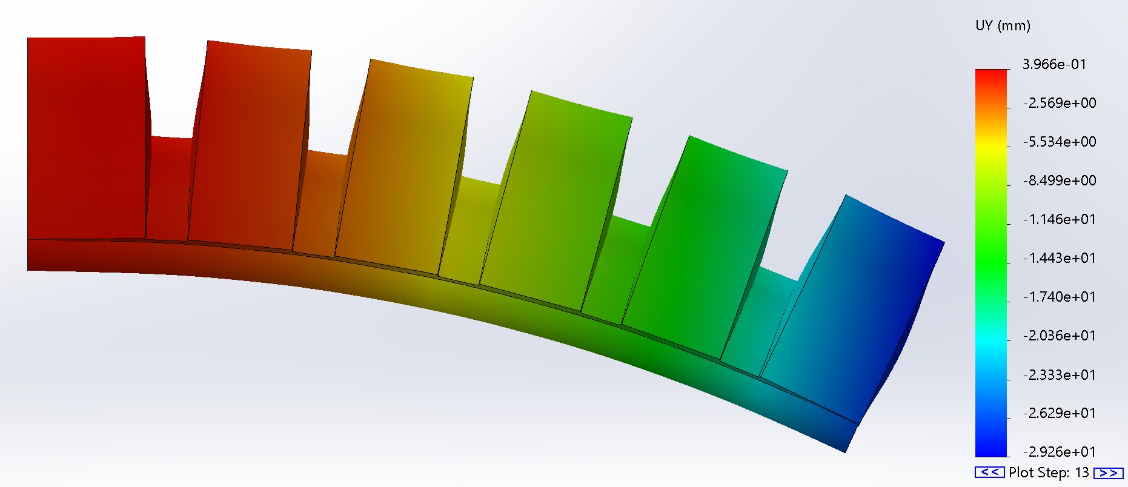
Finless Design Results

Slide 6
For Next Week
Zoom with Ally and Tim (you and I discuss) -
Printing issues (Potentially reprint 4 chamber model)
2 vs 3 vs 4 chamber model – Stiffness via thickness or design elements
Printing more designs
Make all necessary design changes to get a proper print
Get air compressor and begin testing on on-hand model
Run 5 psi column for 4 chamber model
Build a testing rig
Build different model with thicker fluid model
Square Helix design
Organize Dim Lab Folder
Thursday meeting next week

